Slide 1
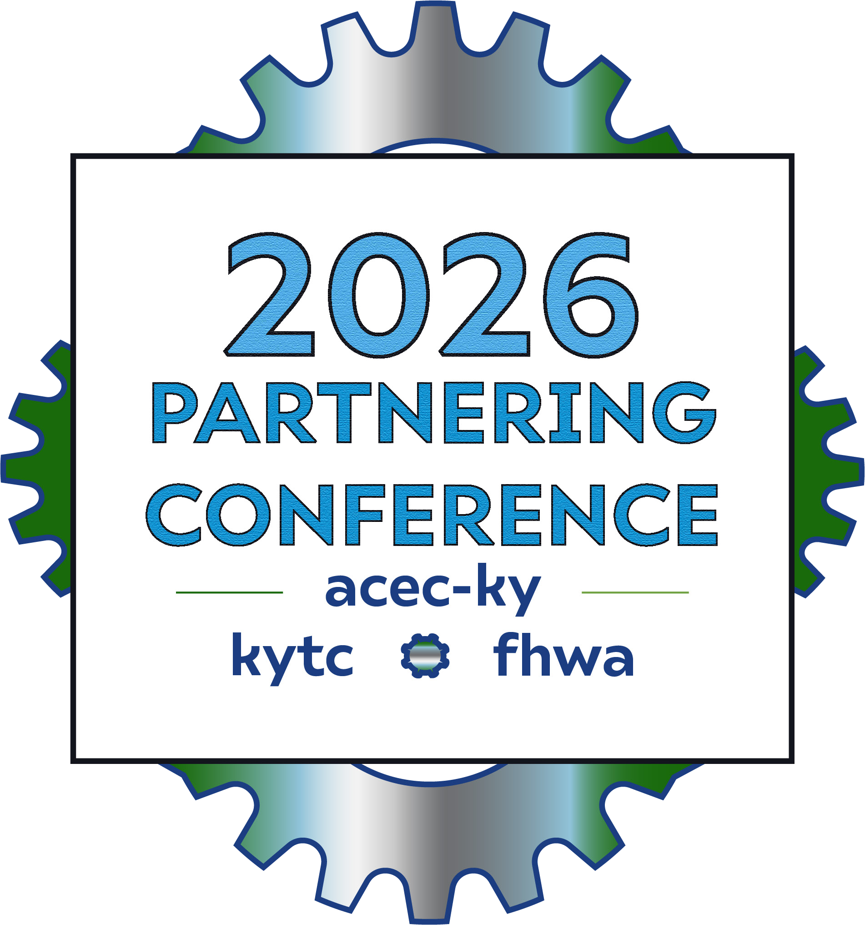

Reducing Construction Conflicts
Kevin Wolfe, President Haydon Bridge
Chad Conley, Executive Vice President Hinkle Construction
Katy Stewart, KYTC Division of Construction
Ben Kidd, KYTC Division of Construction
Joseph Van Zee, KYTC Division of Structural Design

Slide 2

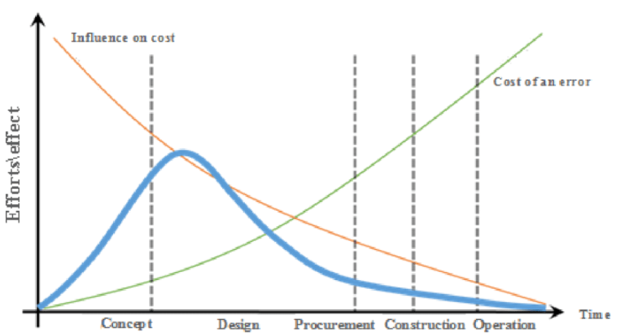


Slide 3

Construction Conflicts
Utilities
Phasing
Substructure Types
MOT
Lump Sum Items
Waste/Borrow
Completion Dates

Slide 4
Utilities
Question:
How common are utility conflicts during construction and what is the general impact to construction/project? Give examples if possible.

Slide 5
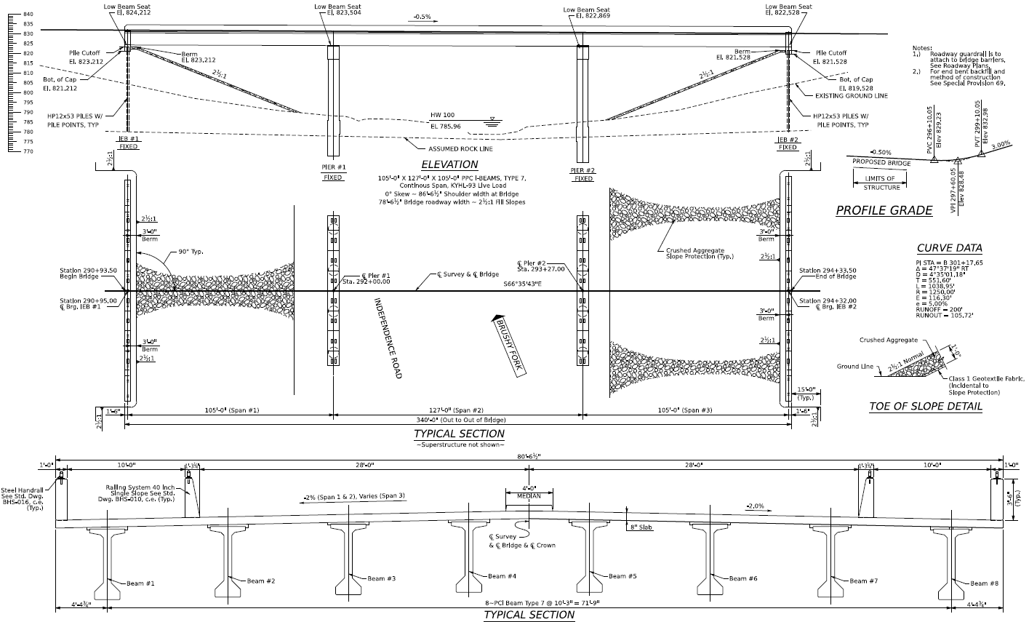
Utilities

Slide 6
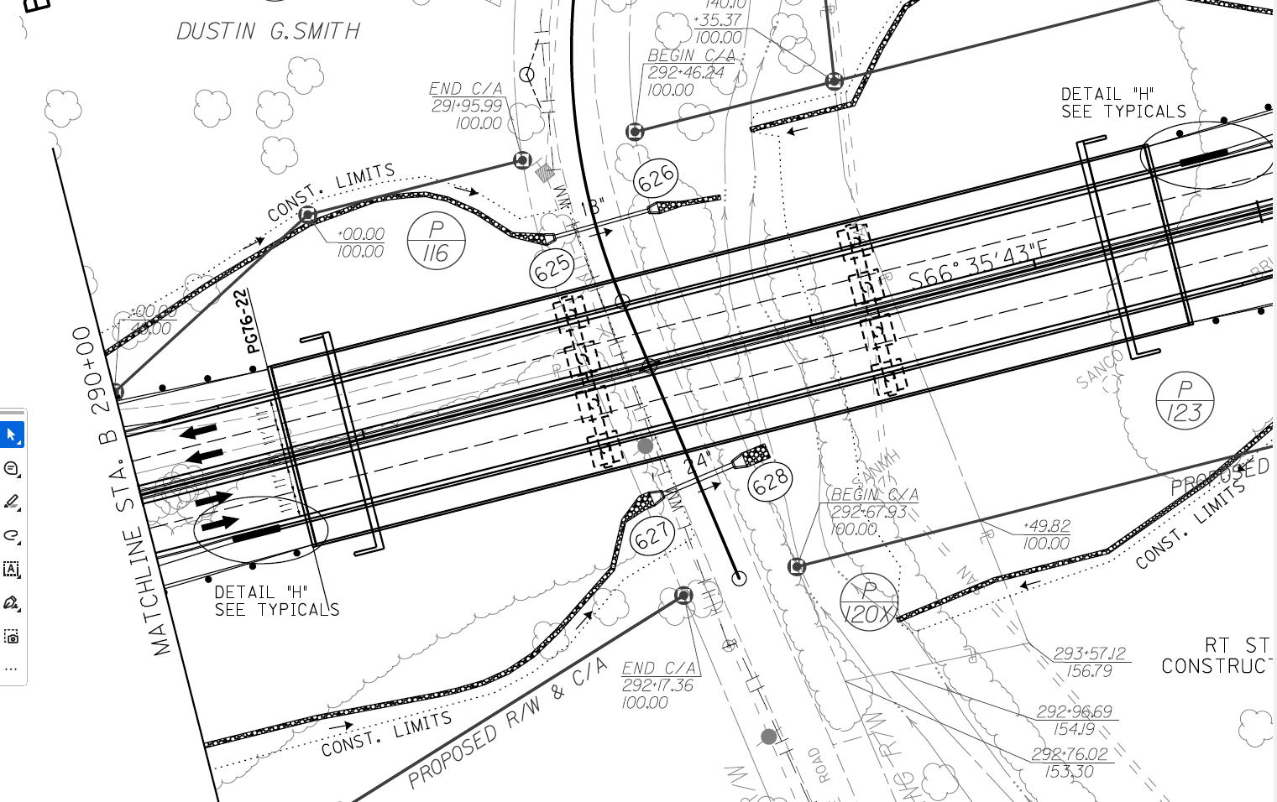
Utilities

Slide 7
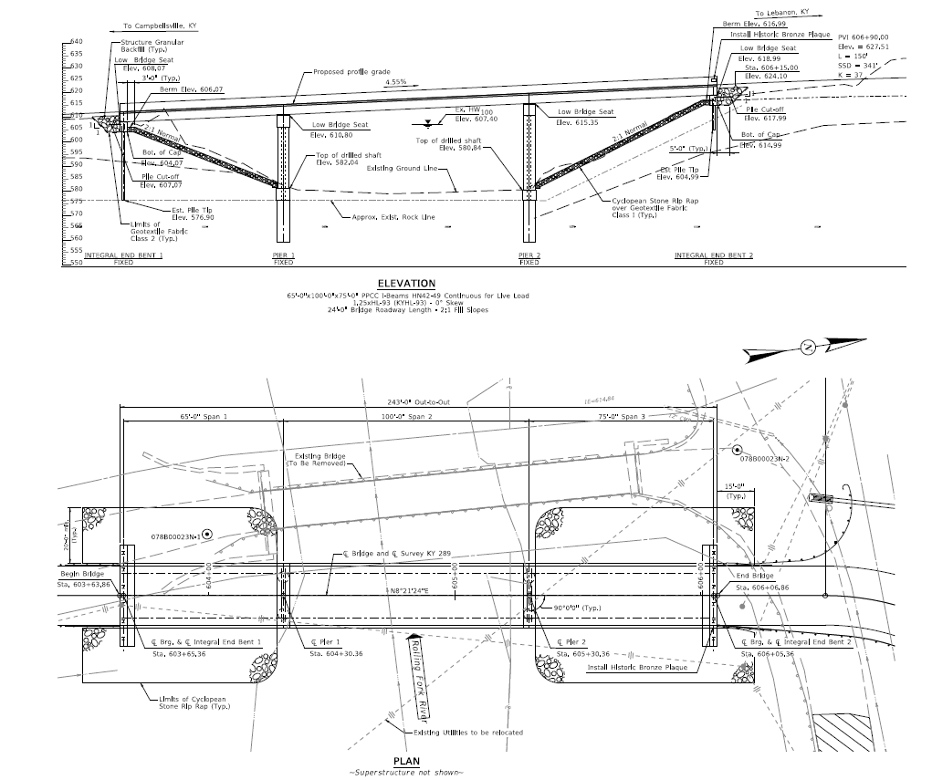
Utilities

Slide 8
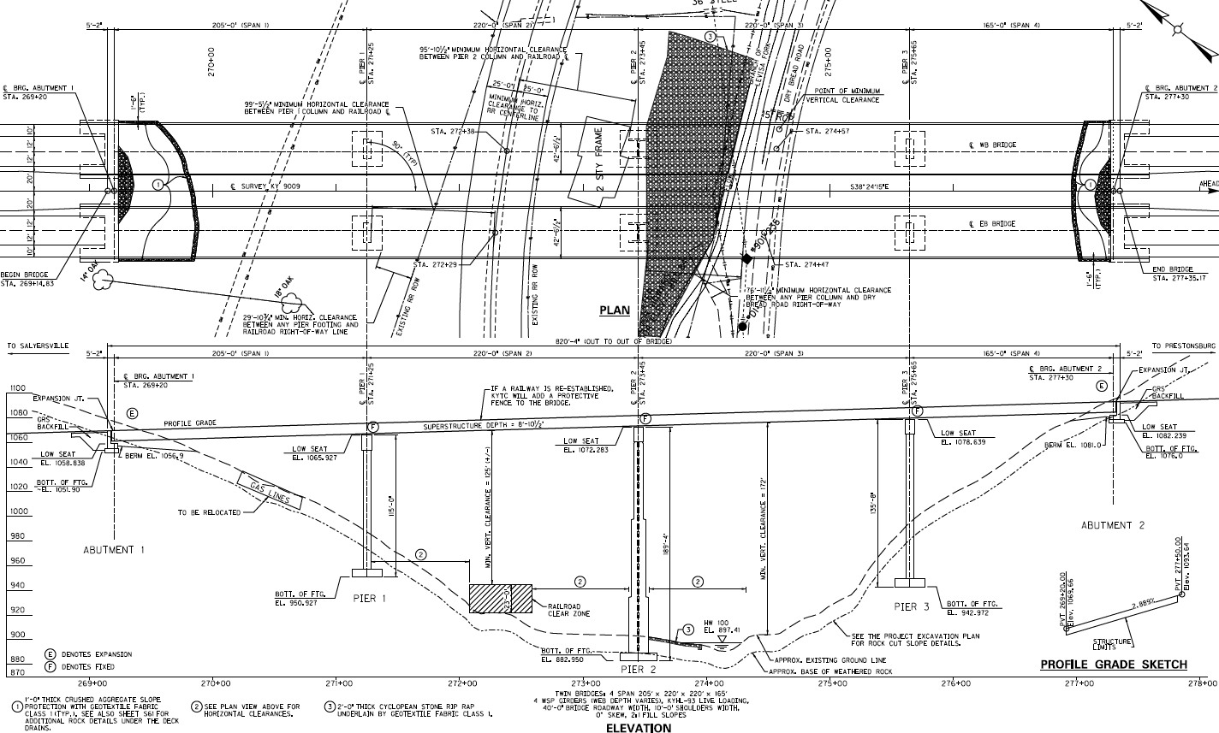
Utilities

Slide 9
Phasing
Question:
A careful consideration of project phasing is critical during the design phase to be able to construct a project. What are some issues you have run into and what do designers need to do to avoid those in the future?

Slide 10
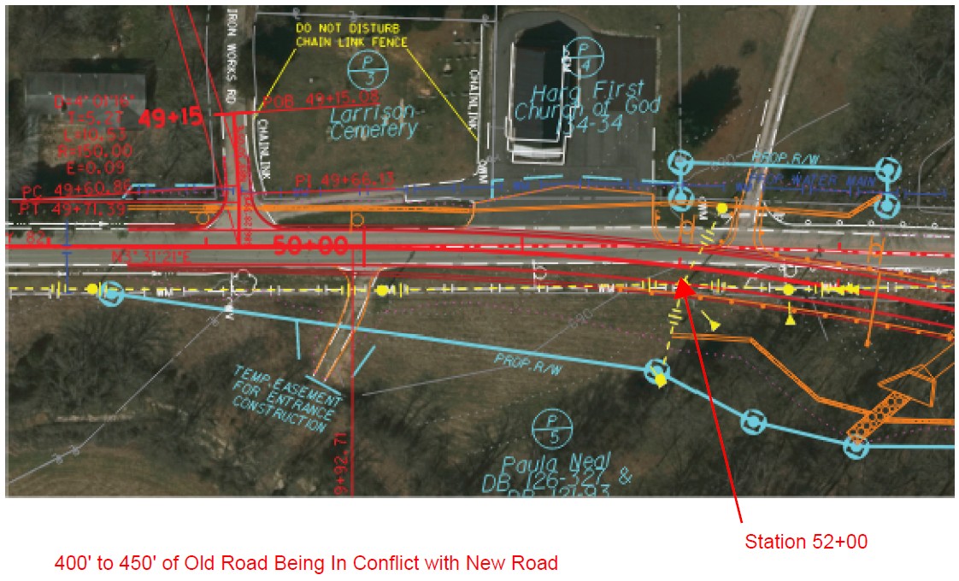
Phasing

Slide 11
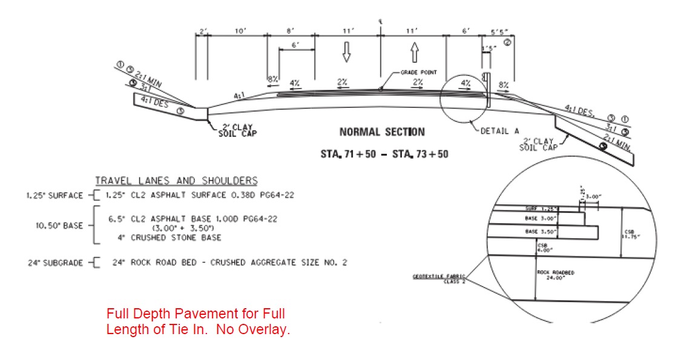
Phasing

Slide 12
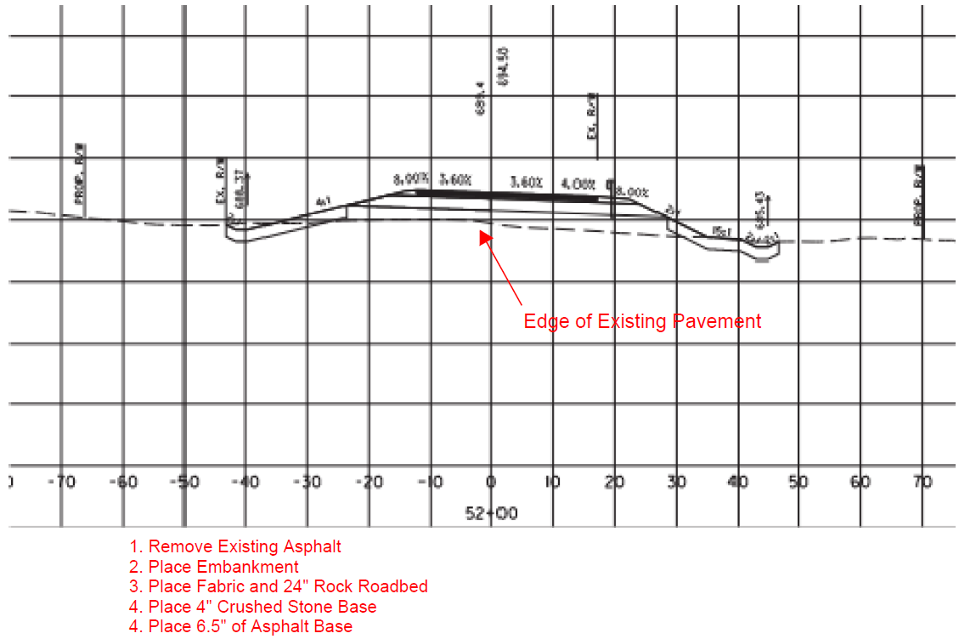
Phasing

Slide 13
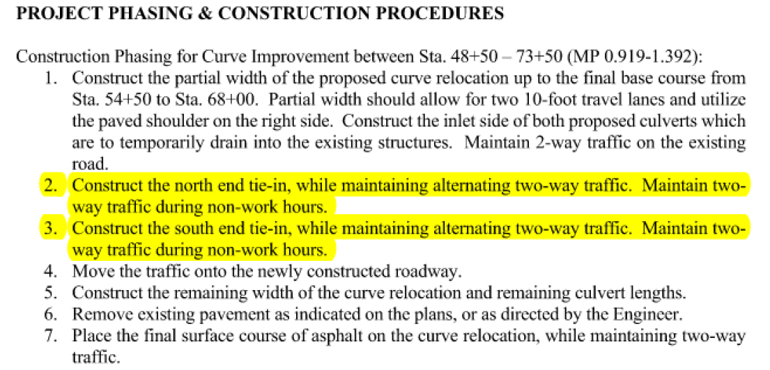
Phasing

Slide 14
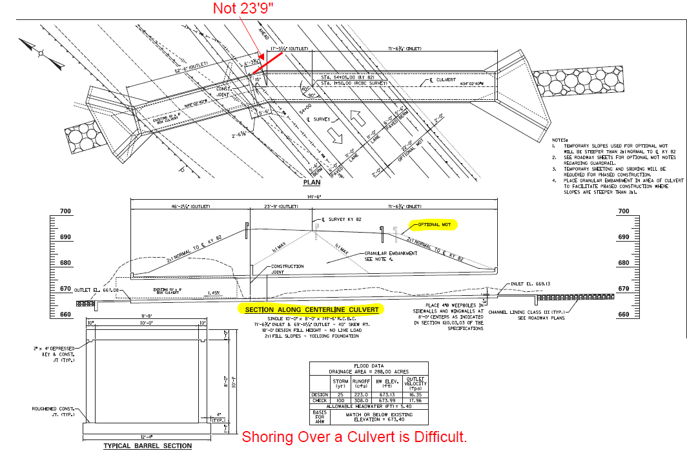
Phasing

Slide 15
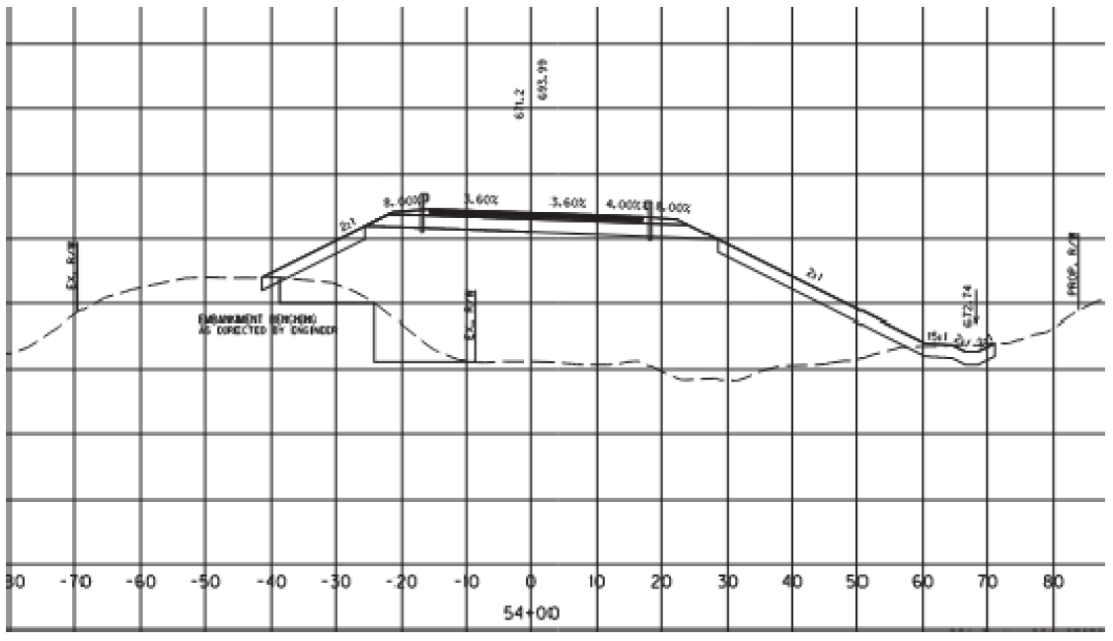
Phasing

Slide 16
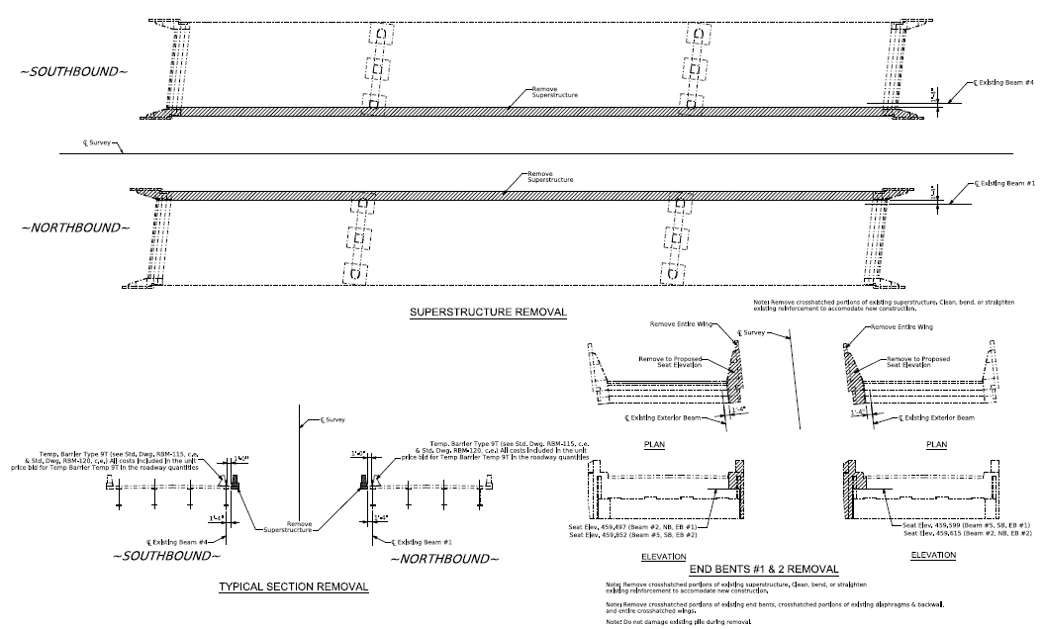
Phasing

Slide 17
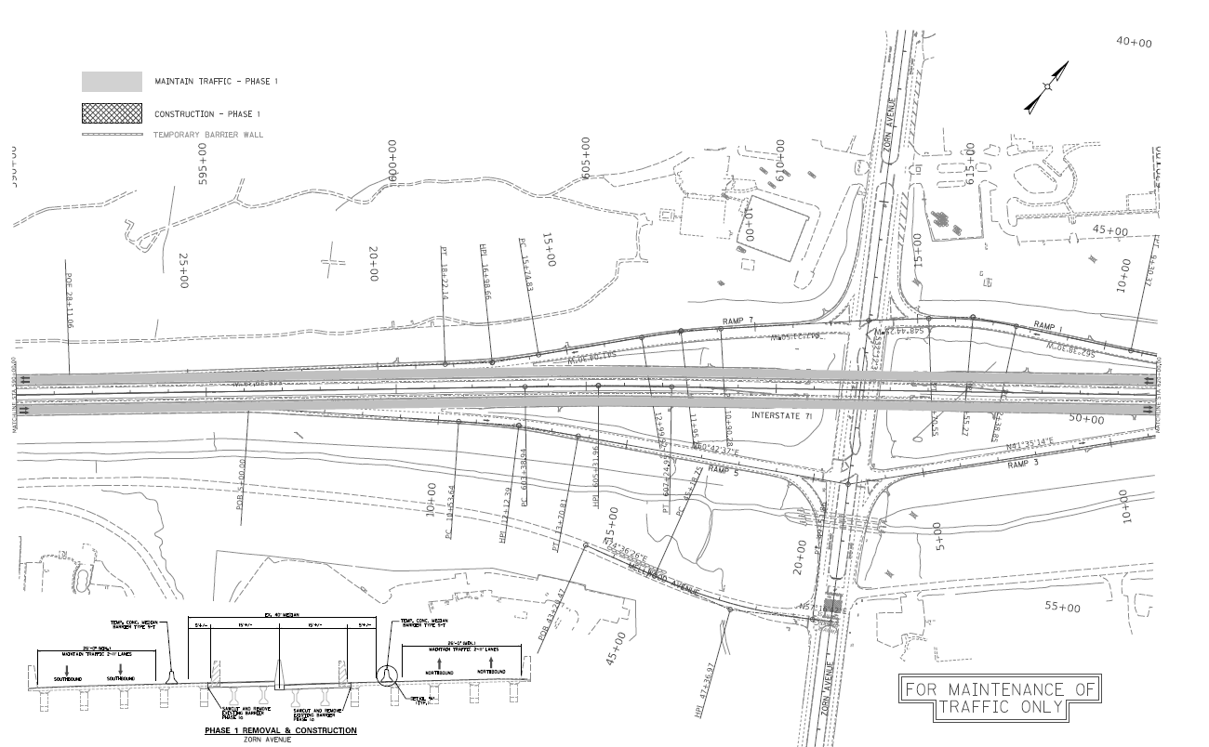
Phasing

Slide 18
Substructure Types
Question:
Contractors can build anything we draw right? So why does it matter on what substructure types we choose for bridges?

Slide 19
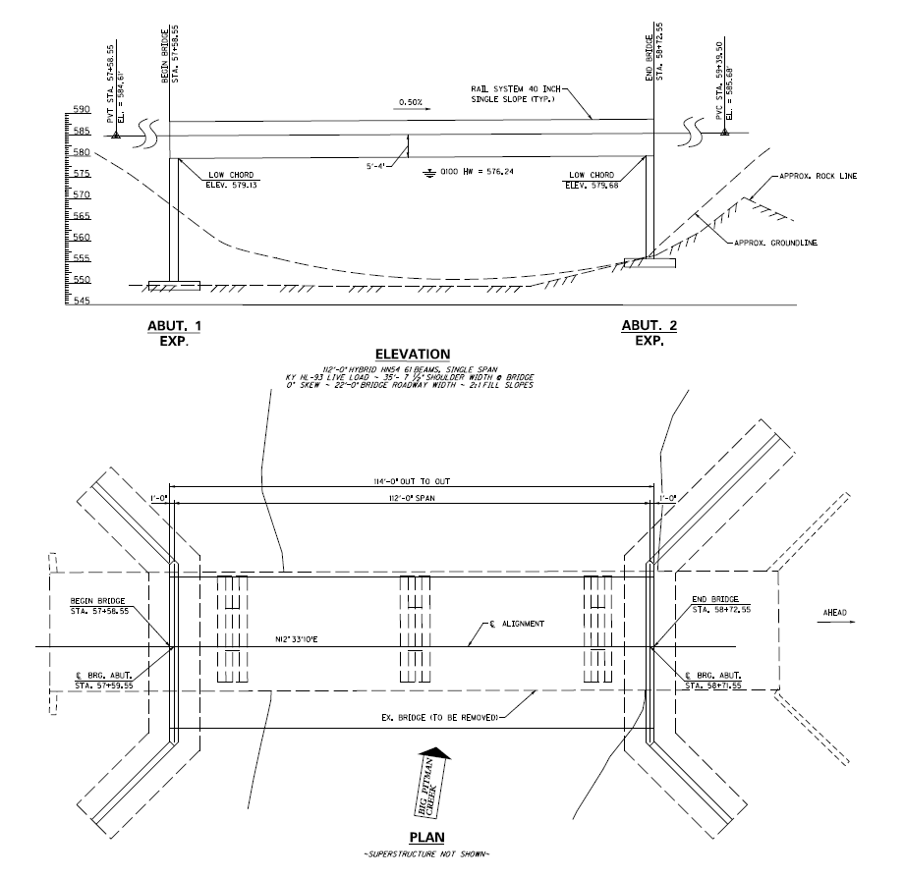
Substructure Types

Slide 20
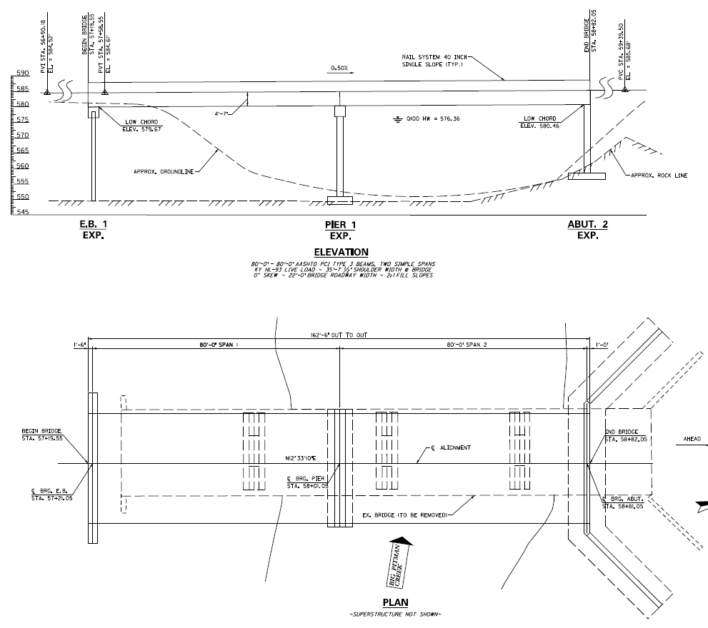
Substructure Types

Slide 21
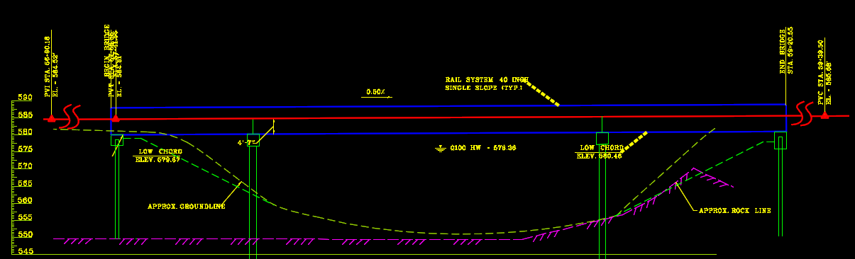
Substructure Types

Slide 22
Substructure Types
What if phased construction wasn’t being done?
35ft abutments will never beat a lengthened bridge with a shorter substructure.
Can we shift layout to get piers/footings out of the stream?
If pier has more than 6’ of soil excavation, can we look at drilled shafts as our guidance manual stipulates?
Please ask for guidance from Structural Design when you are not sure which way to go.

Slide 23
MOT
Question:
MOT plans should be detailed enough that field personnel can pick up plans and know exactly how traffic should be routed and signed through the life of the project. What issues arise when this is not done?

Slide 24
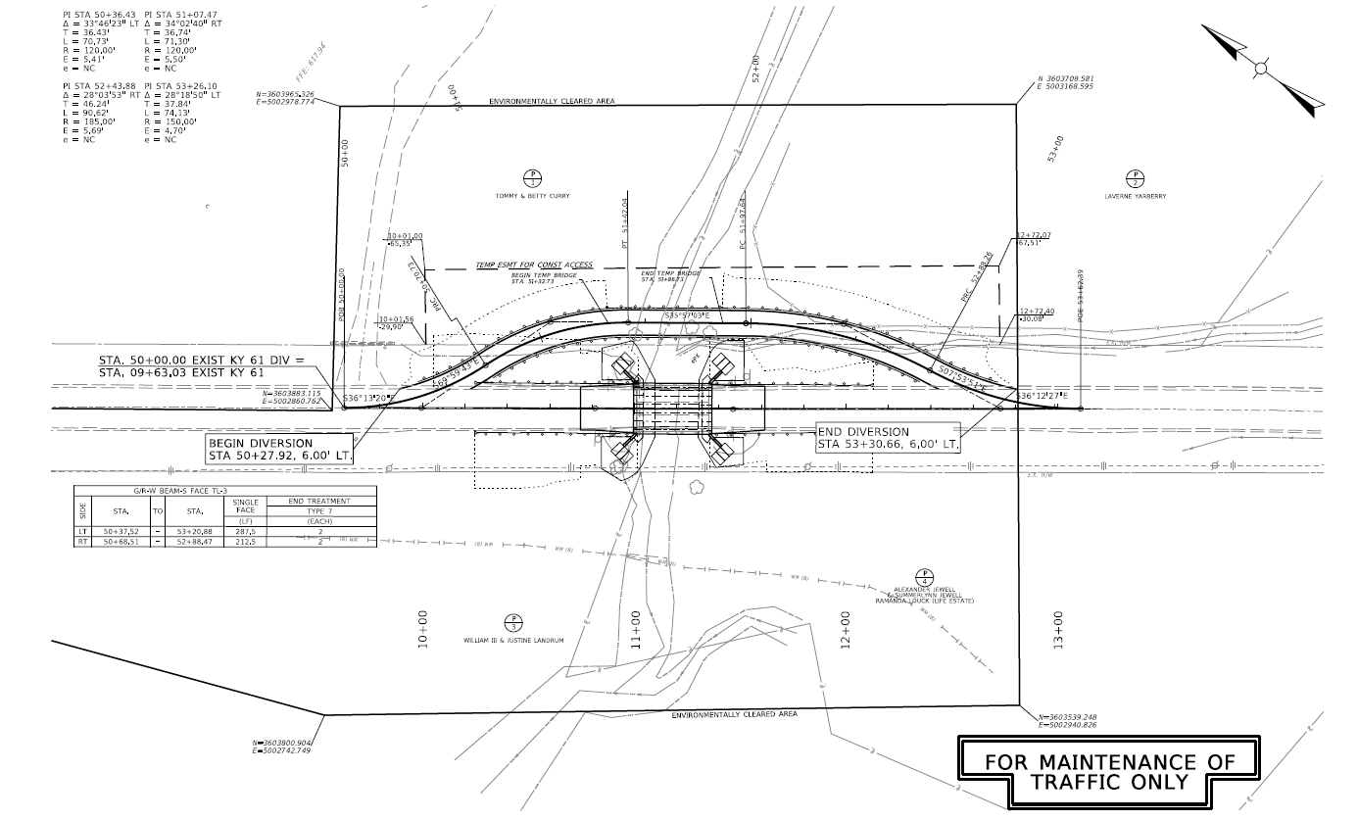
MOT

Slide 25
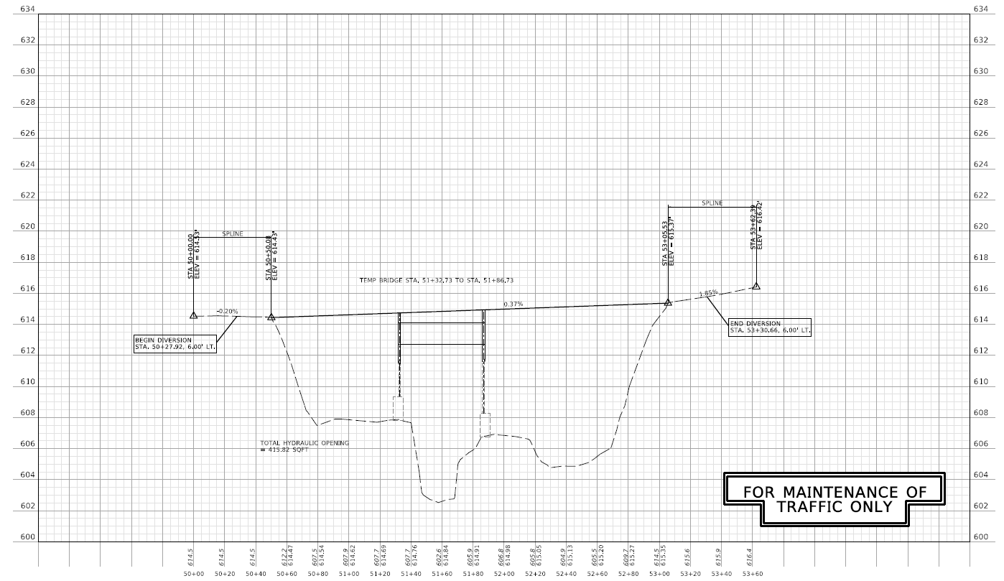
MOT

Slide 26
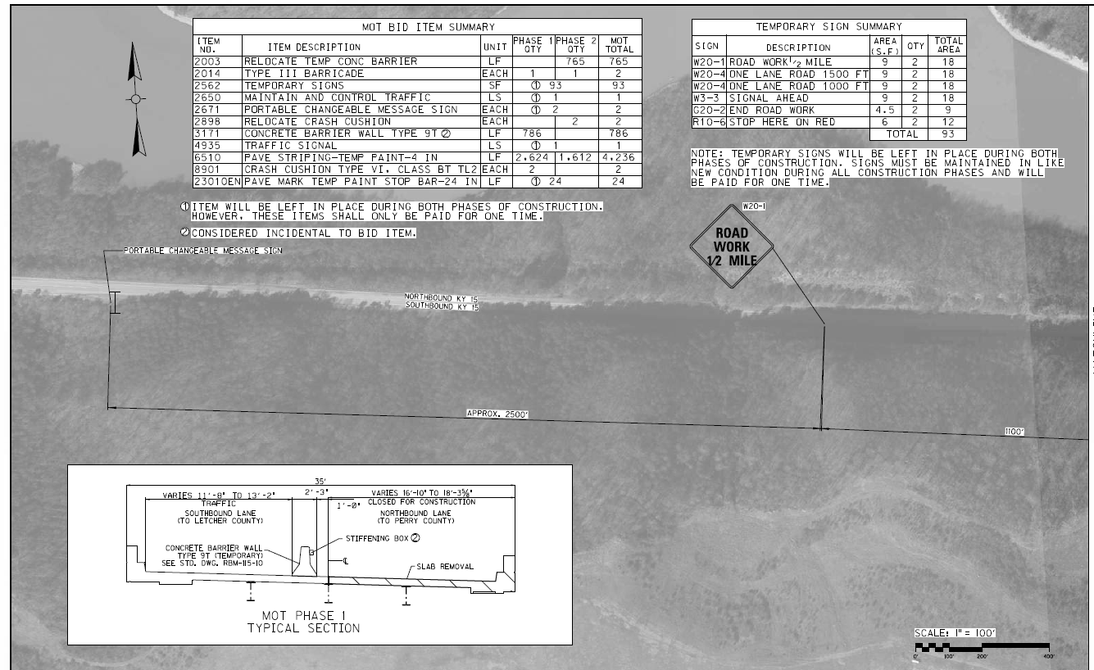
MOT

Slide 27
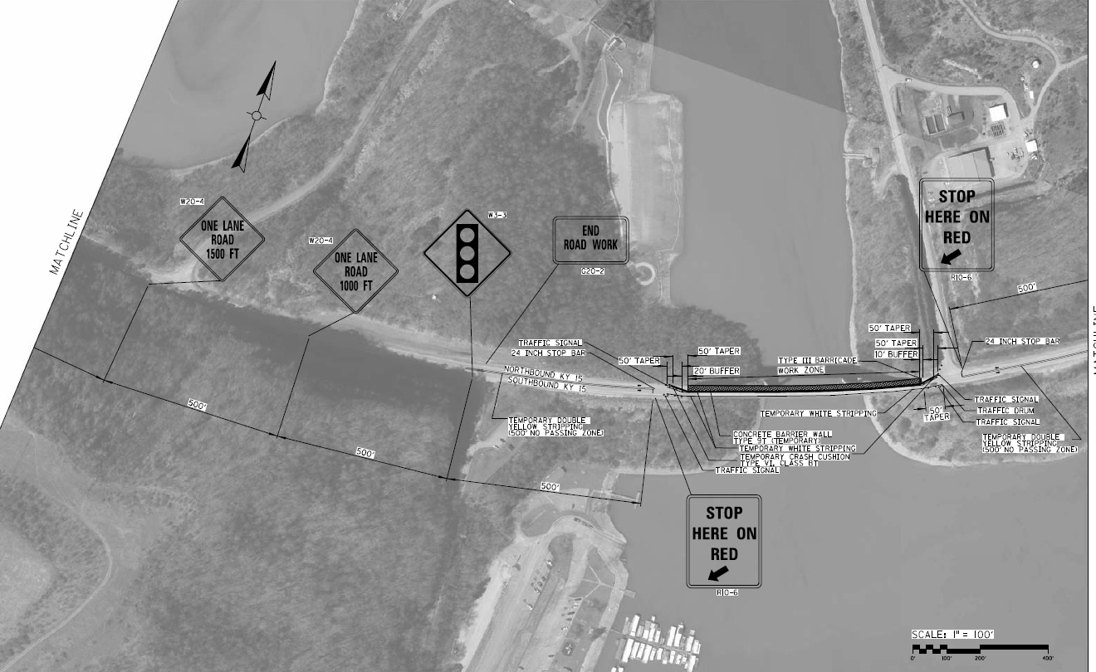
MOT

Slide 28
Lump Sum Items
Question:
A lot of times when a designer may be looking for ease on their part, a lump sum item may be used. (For example, MOT signage, paving items, etc.) Where do you all typically see this and what issues does it cause in construction?

Slide 29
Waste/Borrow Sites
Question:
On large roadway projects with a lot of waste/borrow, what are the typical ways you see this handled in KYTC projects and what issues arise from this?

Slide 30
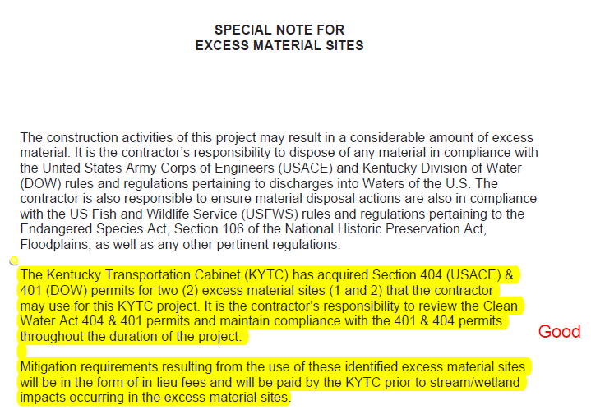
Waste/Borrow Sites

Slide 31
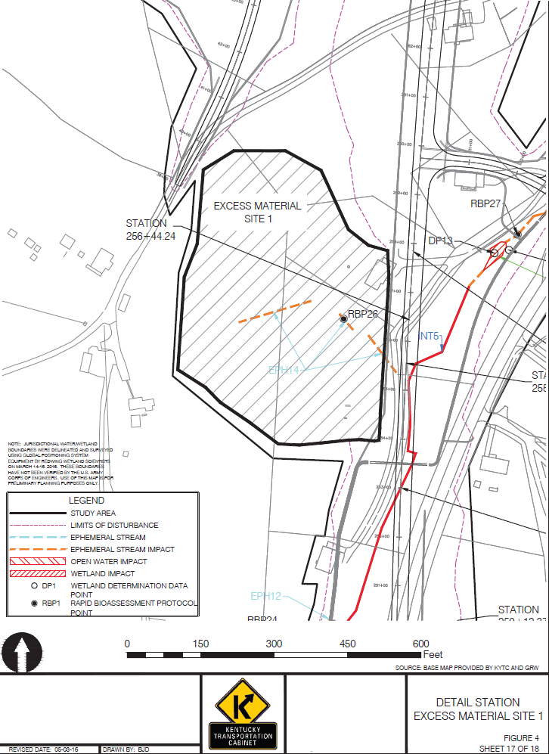
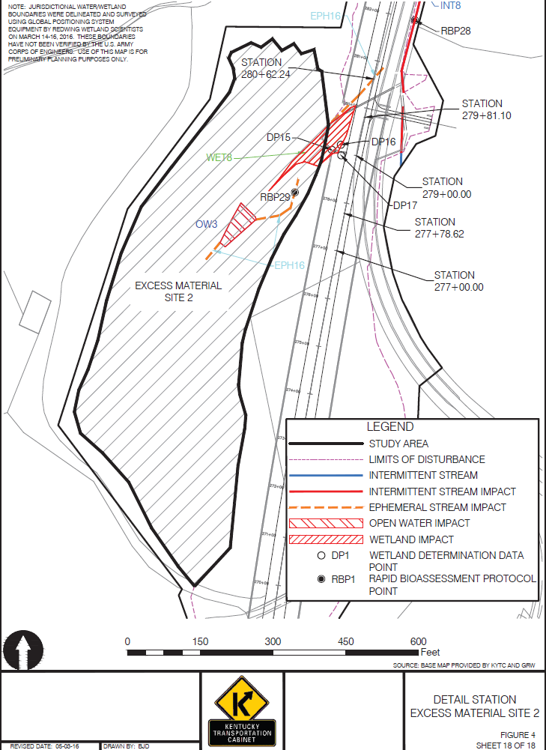
Waste/Borrow Sites

Slide 32
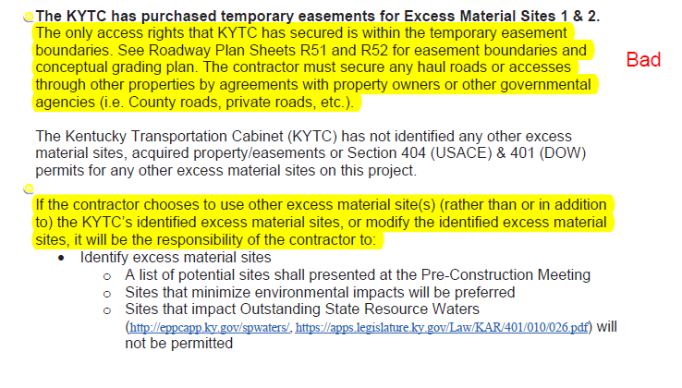
Waste/Borrow Sites

Slide 33
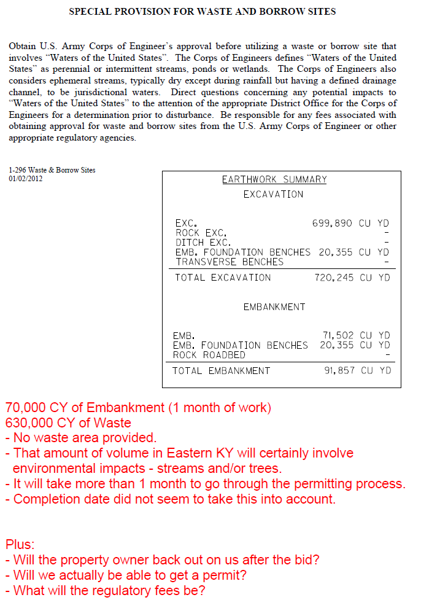
Waste/Borrow Sites

Slide 34
Completion Dates
Question:
Everybody would like their project to be priority and finish ASAP, but what issues arise from choosing completion dates too soon?

Slide 35
Thanks!
Any Questions?

